Slide 1
Housing Price Prediction
-BY
Mahak devi

Slide 2
OUTLINE
Introduction
Problem Statement
Technology Used
Introduction to Machine Learning
Key Features of the Project

Slide 3
INTRODUCTION
Buying a house is a stressful thing. Buyers are not generally aware of the factors that affect the house prices. Many problems are faced during buying a house and hence a real estate agents are trusted between buyers and sellers as well as laying down a legal contract for the transfer. This just creates a middle man and increases the cost of houses.
They believe it depends upon:
Square foot area
Neighborhood
The no. of bedrooms.
But it depends upon other factors as well , such as:
Area Outside the house
No. of storeys
No. of rooms on one floor

Slide 4
For so many years there is one thing that it’s that housing and rental prices continue to rise. Since the housing crisis of 2008, housing prices have recovered remarkably well, especially in major housing markets. However, in the 4th quarter of 2016, I was surprised to read that housing prices had fallen the most in the last 4 years. In fact, median resale prices for condos and coops fell 6.3%, marking the first time there was a decline since Q1 of 2017. The decline has been partly attributed to political uncertainty domestically and abroad and the 2014 election. So, to maintain the transparency among customers and also the comparison can be made easy through this model. The average annual price change across 56 countries and territories was recorded at 10.3%, according to the report.
If customer finds the price of house at some given website higher than the price predicted by the model, so he can reject that house.

Slide 5
PROBLEM STATEMENT
Thousands of houses are sold every day.
There are some questions every buyer asks himself like :
What is the actual price that this house deserves ?
Am I paying a fair price ?

Slide 6
Software Used
TECHNOLOGY USED :MACHINE LEARNING
TOOL USED
Python
Google colaboratory
LIBRARIES USED
Pandas
NumPy
Matplotlib

Slide 7
PSEUDO CODE
The steps are used to implement the house price prediction model is depicted as pseudo code Pseudo Code: House price prediction
Step 1: Load the datasets.
Step 2: Summarize the data distribution range using Visualization tool.
Step 3: Identify the prevalent features using correlation tool.
Step 4: Split the input dataset into train and test.
Step 5: Transform the data to fed into machine learning models.
Step 6: Invoke XGBoost Regressor.
Step 7: Summarize the performance in terms rating and strength of a models using metric

Slide 8
Linear Regression Machine Learning for the Project
Linear Regression is a Supervised Machine Learning Model for finding the relationship between independent variables and dependent variables. Linear Regression performs the task to predict the response(dependent) variable value (y) based on a given (independent) explanatory variable(x). So, this regression technique finds out a linear relationship between x (input) and y (output).
Types of Linear Regression:
Single Linear Regression (involving single explanatory variable).
Multiple Linear Regression (involving multiple explanatory variables).

Slide 9
Key Features of the Project
Proposed system is a online browser based application.
The major objective of the system is house price prediction.
Proposed system uses the parameters such as house size , balcony , number of bedrooms and bathrooms , location and some other parameters for house price prediction.
System uses Machine Learning algorithms for price prediction.
System helps real estate in faster decision making.
System is useful for real estate business and also for buyers and sellers

Slide 10
How it works ?
Collecting data: First step is to collect Data . We collected data from different sources and then merged them together to prepare a training dataset.
Training the model: Then we trained the model using machine learning algorithm which in this case is multiple linear regression.
Based on the generated graphs cost of the house is predicted

Slide 11
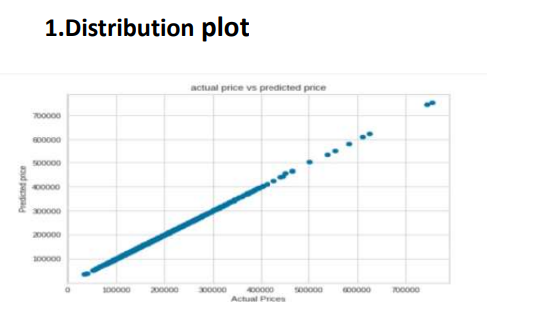
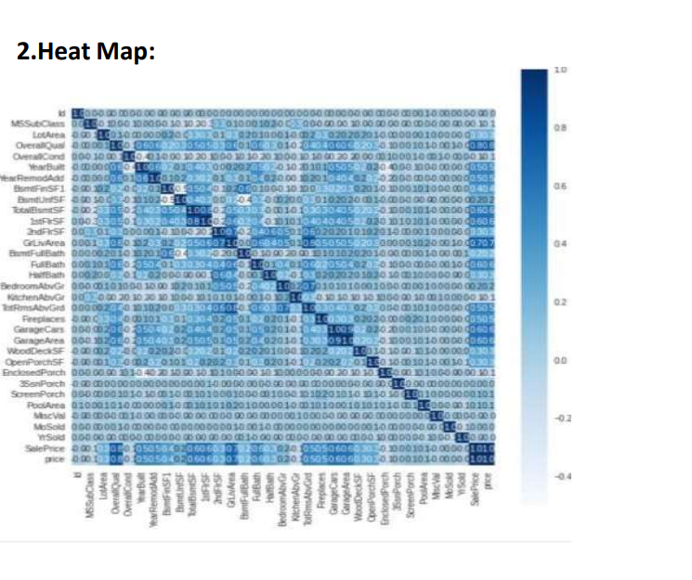
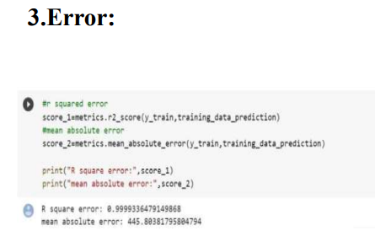
RESULT

Slide 12
THANK YOU

